Slide 1



Typing Polygon
Vision document

Slide 2
Description
Typing Polygon is playground for improving typing skills;
Project provides gaming experience of various game genres in a typing setting;
Game uses technological tools to analyze user typing;
Players can share their own game modes created using the level builder.
Notes:
ff

Slide 3
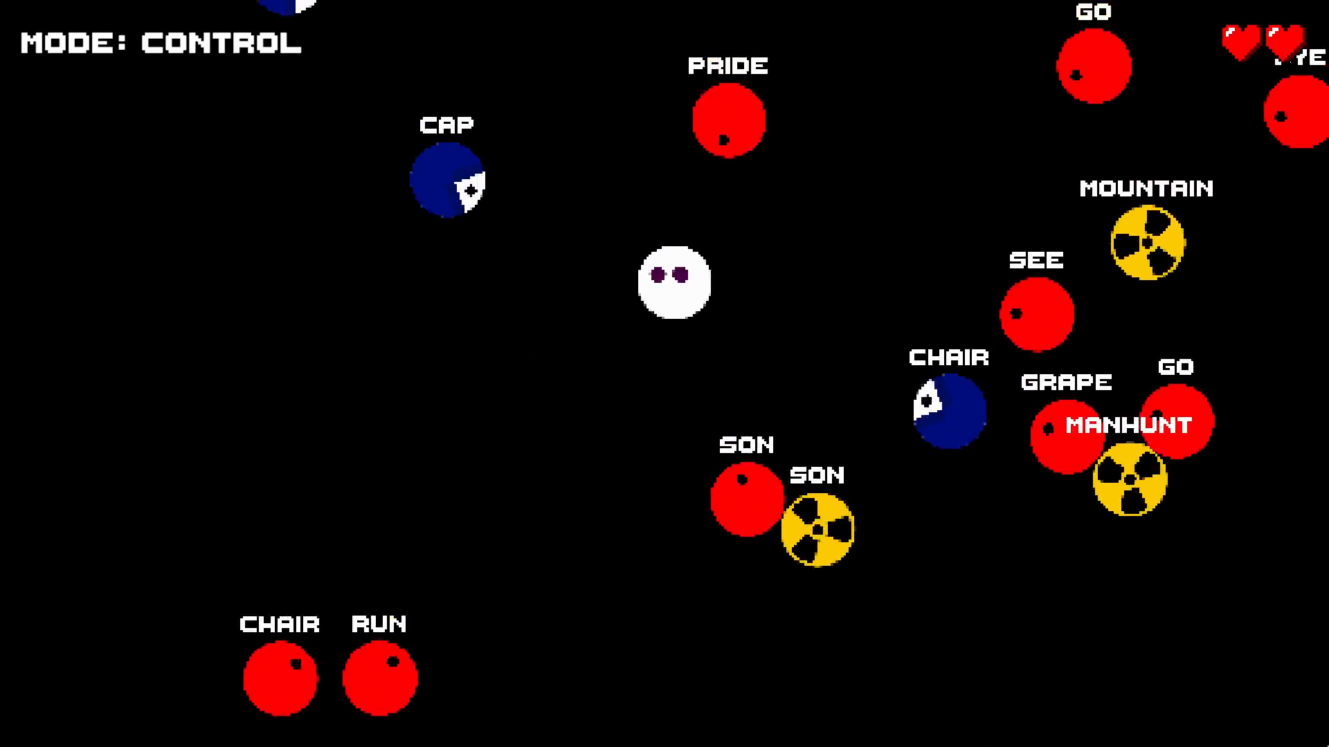
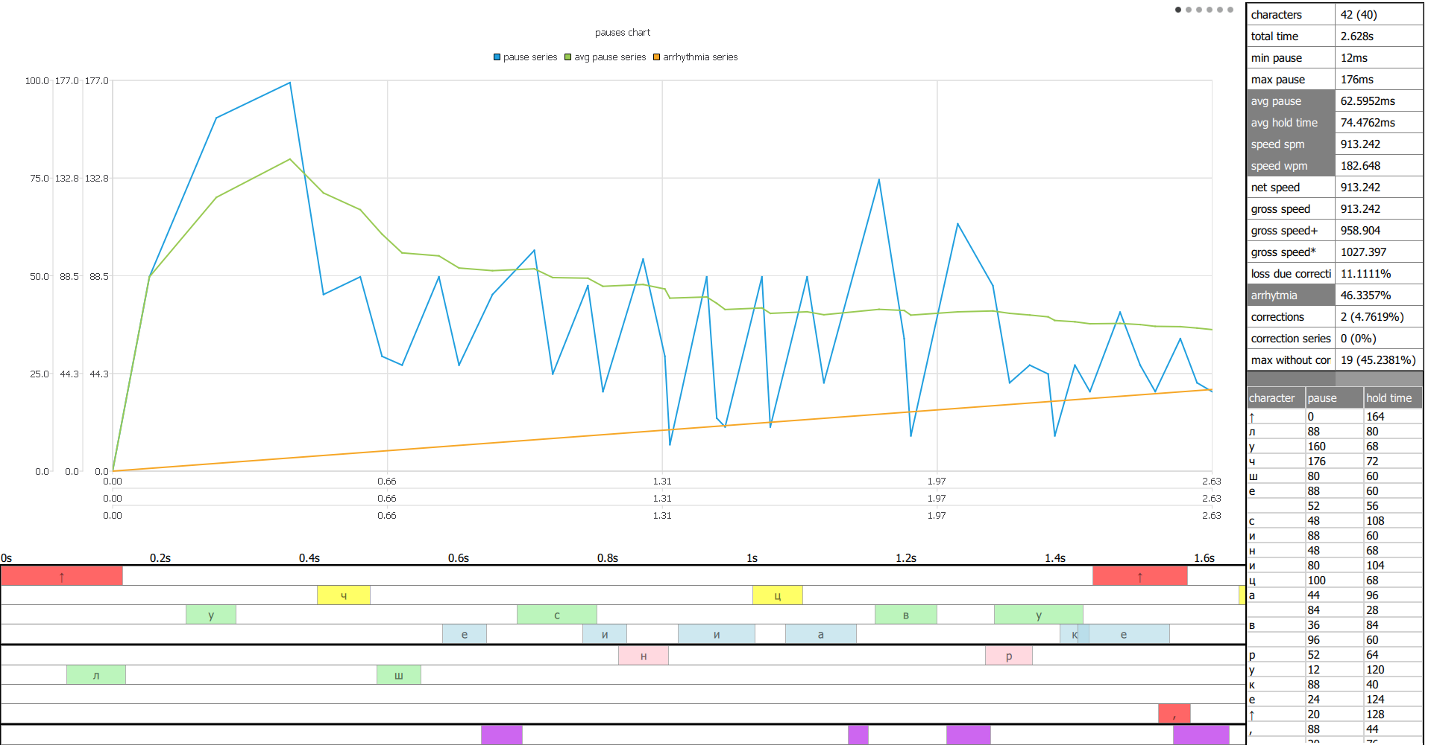
Description
Genre: typing game, action, training sim, multi-genre (includes various game modes of different genres)
USP:
a unique solution of problems with controls in typing games (switching controls with TAB button);
professional tools for typing analysis (developed outside the project);
an in-game constructor that allows users to create their own game modes with their own rules.

Slide 4
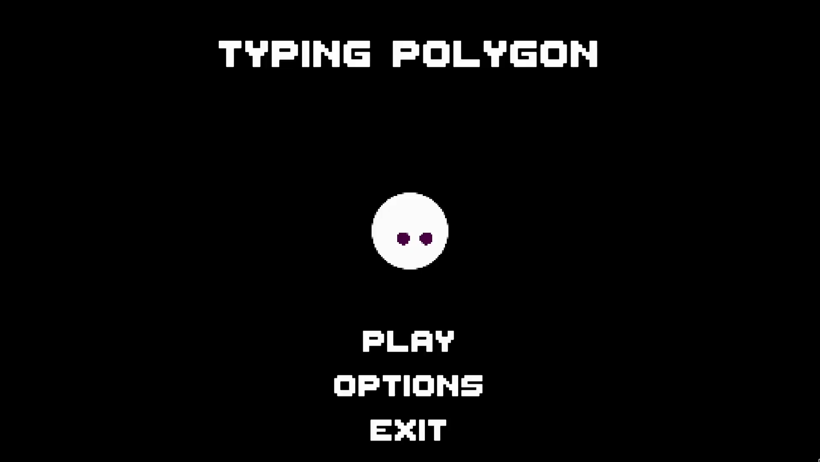
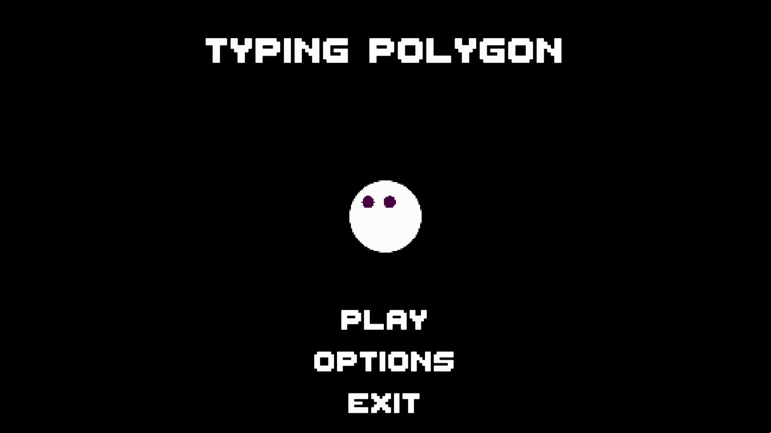
Gameplay
The project is a training polygon with various practice modes and games implemented on the internal engine.
Each game is an interpretation of certain genre in a “typing” setting (e.g. survival game, run & gun, stealth-action and etc.).

Slide 5
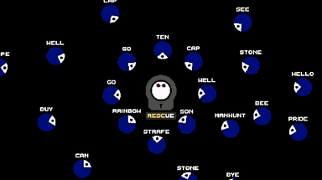
Game Setting
Globally, the game is made in a typing setting, i.e. any interaction with the environment (killing enemies, completing quests, resource collecting) to one degree or another involves typing.
Depending on game mode, the nuances of the setting, as well as the game genres, may vary.

Slide 6
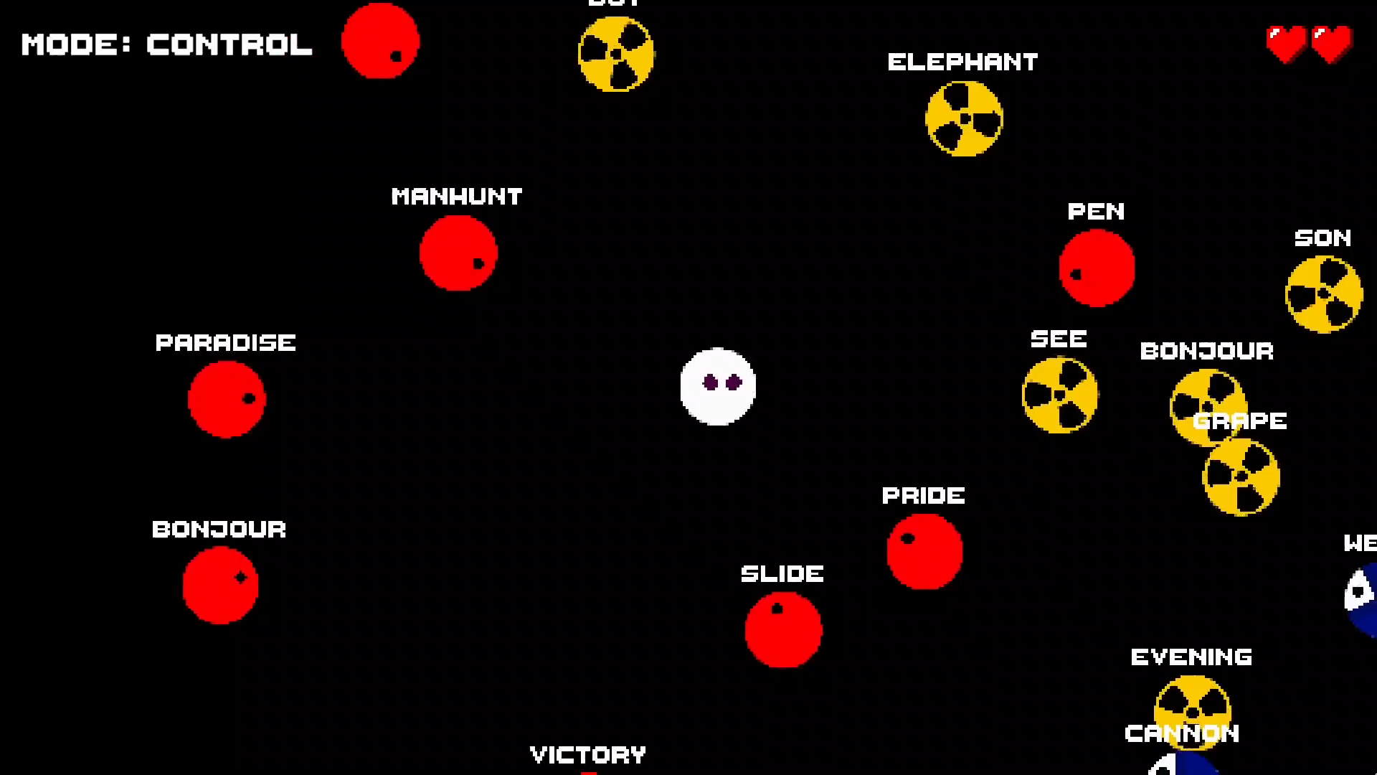
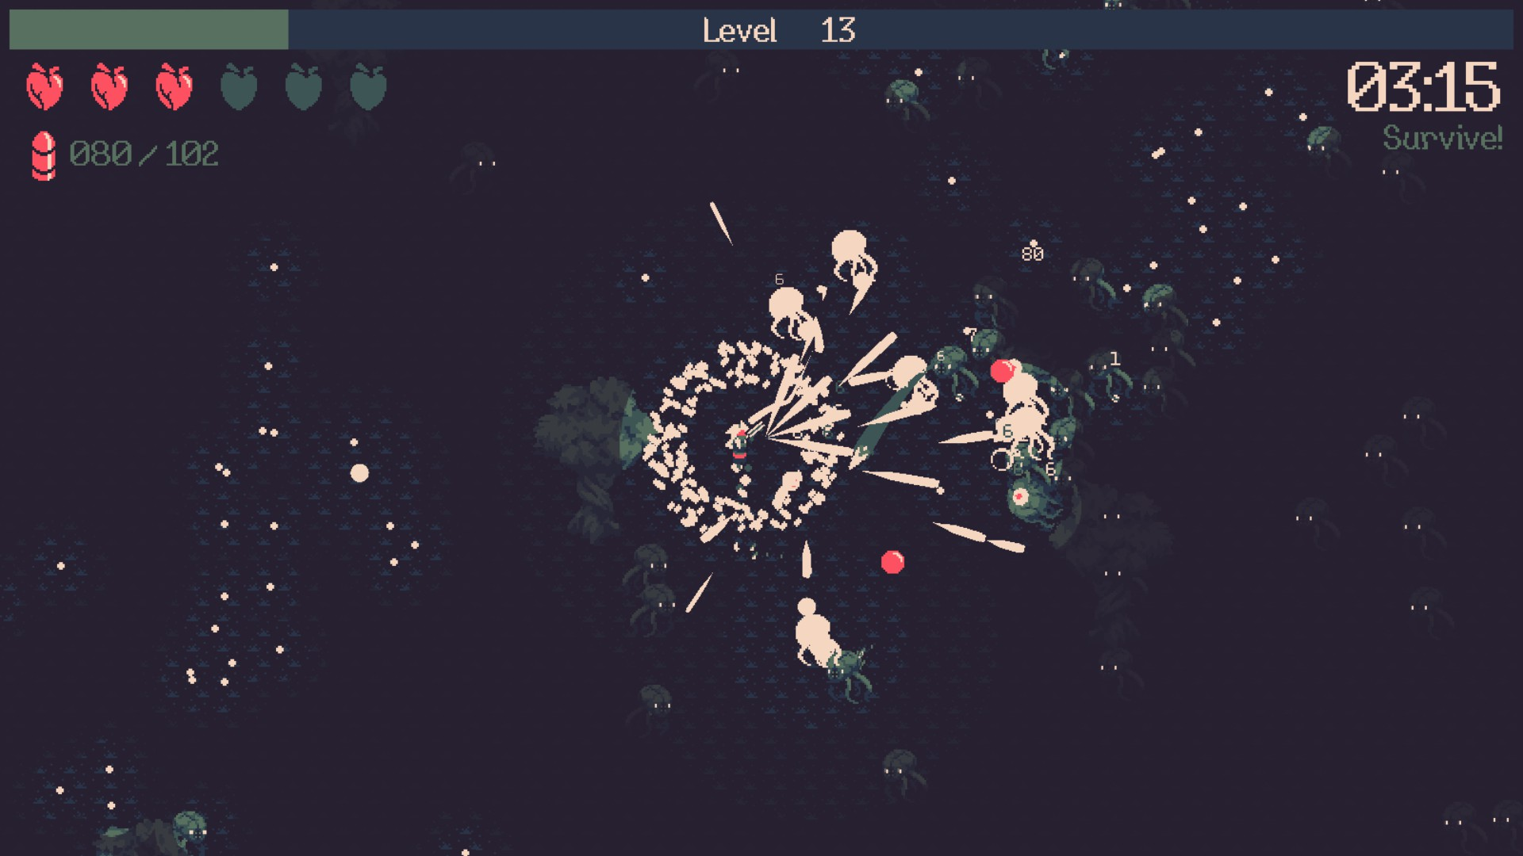
Visual style
The game is made in a minimalistic pixel style and uses a top-down view.
Visual reference: 20 Minutes Till Dawn.

Slide 7
Target audience
Main target audience: People interested in fast typing (any genre and age).
Preferred genres:
Typing games: The Textorcist, Epistory, Outshine
Run & Gun: 20 Minutes Till Dawn, GOONER
Stealth-Action: OGAT
Hobbies:
Typing sites (Klavogonki, 10FastFingers, TypingClub, Ratatype)

Slide 8
Distribution model
The game implements B2P approach with an expanded content in the form of DLC.
TypeRacer, 10FastFingers, Ratatype, Klavogonki – sites that have proven themselves in the field of typing and have a stable, interested audience for 15 years. After a long study of the subject area, we know what is interesting to the target segment.
It is planned to attract the majority of the audience through social networks and thematic forums.

